Slide 1

UNDERSTANDING SLEEP PATTERNS
Sleep Health Discovery
Kofi Ofori-Acquah | CS 4412

Slide 2
Overview of the Sleep Health Dataset
The cleaned dataset includes 374 entries featuring key indicators such as sleep duration, stress levels, and cardiovascular health.

Slide 3
Clustering and Visualization Methods in Sleep Health
K-Means Clustering
PCA Visualization
Anomaly Detection
K-Means was employed to identify interpretable sleep-health segments, revealing distinct lifestyle patterns within the data that are critical for understanding individual health.
Principal Component Analysis enabled a two-dimensional visualization of the data structure, effectively illustrating the separation of clusters and enhancing interpretability of complex relationships.
Local Outlier Factor was utilized to identify unusual profiles, focusing on edge cases that warrant further investigation, thereby providing deeper insights into sleep health variations.

Slide 4
Six Distinct Segments
The K-Means clustering method revealed six unique sleep-health profiles, indicating diverse lifestyle patterns that differ significantly from a single, homogeneous population structure.
The silhouette score of 0.537 substantiates the robustness of these clusters, demonstrating that the dataset indeed contains multiple distinct groups rather than a uniform distribution.
This discovery highlights the complexity of sleep health, showcasing how various lifestyle factors intertwine, thus emphasizing the importance of individualized approaches to sleep health assessment.

Slide 5

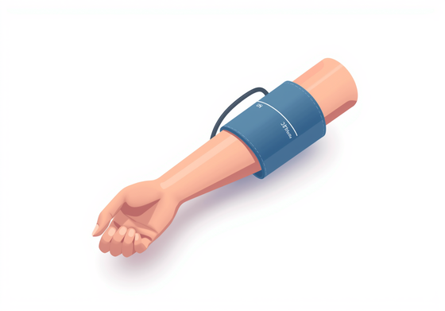

Distinguishing Features of Groups
Blood Pressure
Heart Rate
Physical Activity
Higher readings signify significant health concerns.
Variability impacts overall cardiovascular fitness levels.
Active lifestyles promote improved sleep health outcomes.

Slide 6
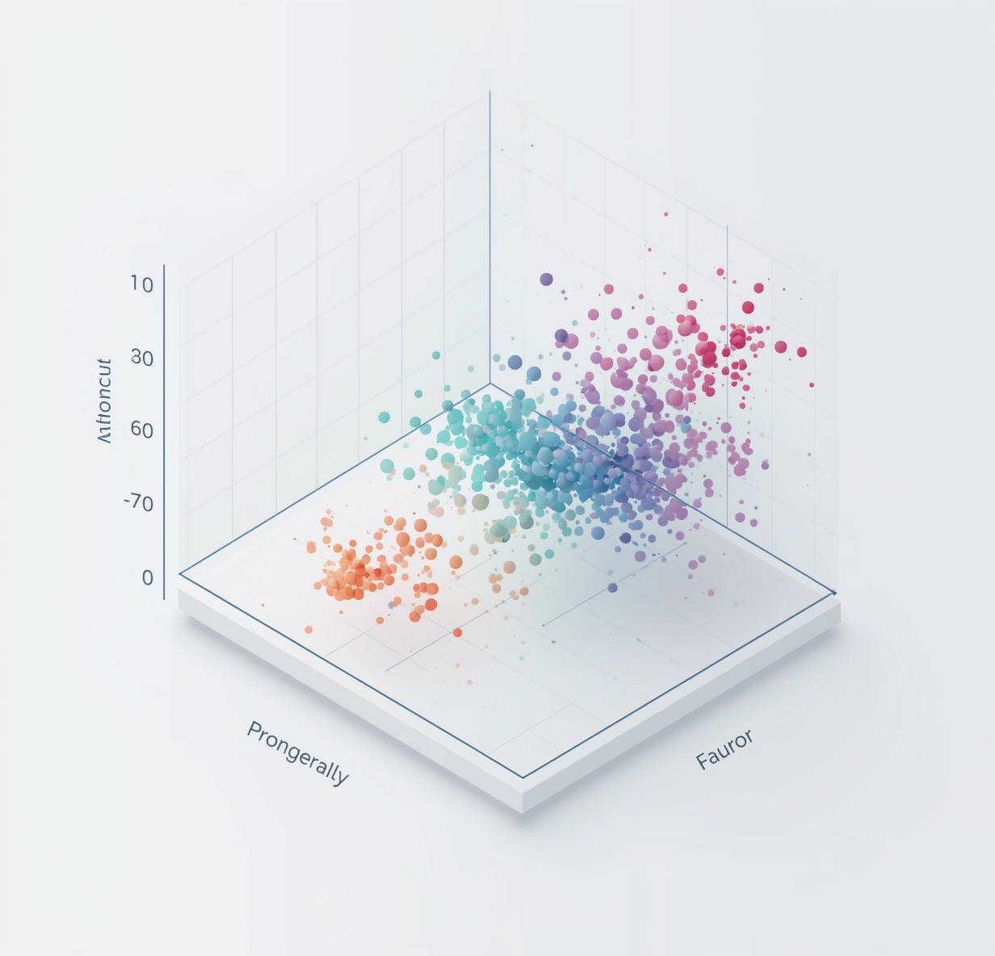
70%
Variance Explained by PCA
PCA captured about 70% of the variance, revealing clear separation between clusters visually.

Slide 7
Identifying Anomalies: Insights from LOF Analysis
Unusual Profiles Detected
Not Just Poor Data
Importance of Investigation
The LOF method revealed 18 unique profiles, representing about 5% of the dataset, highlighting their significance in understanding sleep-health patterns.
These anomalies reflect unusual combinations of activity, stress, and cardiovascular indicators, indicating potential edge cases worth further exploration.
Profiles identified by LOF warrant individual attention, as they may offer insights that differ from general cluster narratives, enhancing our understanding of sleep health.

Slide 8
Confidence and Limitations of Findings
The analysis reveals several insights while acknowledging limitations:
Confidence Level: Moderate, supported by two clustering methods and PCA validation.
Limitation 1: Clustering is unsupervised; no true labels exist.
Limitation 2: Results rely on subjective interpretation of cluster profiles.
Limitation 3: Observational data indicates association, not causation.
Technical Caution: Decision Tree and Naive Bayes clarify clusters but do not validate independently.
These limitations highlight the need for careful interpretation of the findings. While the clustering methods provide valuable insights into sleep-health patterns, the absence of established labels and the potential for subjective biases should be considered. Future research could address these limitations by incorporating supervised methods, larger datasets, and rigorous validation techniques, ultimately leading to a more comprehensive understanding of sleep health dynamics.

Slide 9
Handle data with care and respect.
Data sensitivity calls for ethical responsibility.

Slide 10
Conclusion & Next Steps
Insights and directions for future exploration

